Slide 1

Managing Qualitative Knowledge in Software Architecture Assesment
SAABNet
Jilles van Gurp &
Jan Bosch
Högskolan Karlskrona/Ronneby in Sweden
Department of Software Engineering & Computer Science

Slide 2
Contents
Qualitative Knowledge in SD
SAABNet
Validation results

Slide 3
Software Development
no quantitative information early in the design process
requirements spec.
design
greater role of metrics in assessment
implementation
test
deployment

Slide 4
But
Defect fixing becomes more expensive later in the development process
So there is a need to do assessments early on
There is not enough quantitative information available to use existing techniques

Slide 5
Qualitative Knowledge
Examples
  expert knowledge
  general statistical knowledge
  design/architecture patterns
Informal
Badly documented

Slide 6
How to use Qualitative Knowledge
Assign expert designers to team
Do peer reviews of requirement specs. and designs
Try to document the knowledge
Use AI

Slide 7
Bayesian Belief Networks
Model probabilistic distributions using information about dependencies between the variables
Are an excellent way to model uncertain causal relations between variables
SAABNet (Software Architecture Assessment Belief Network)

Slide 8
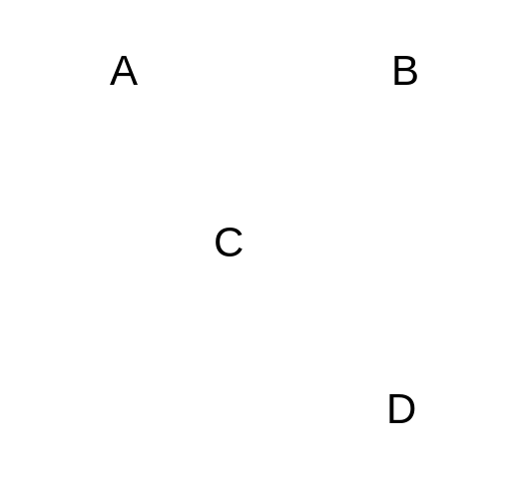
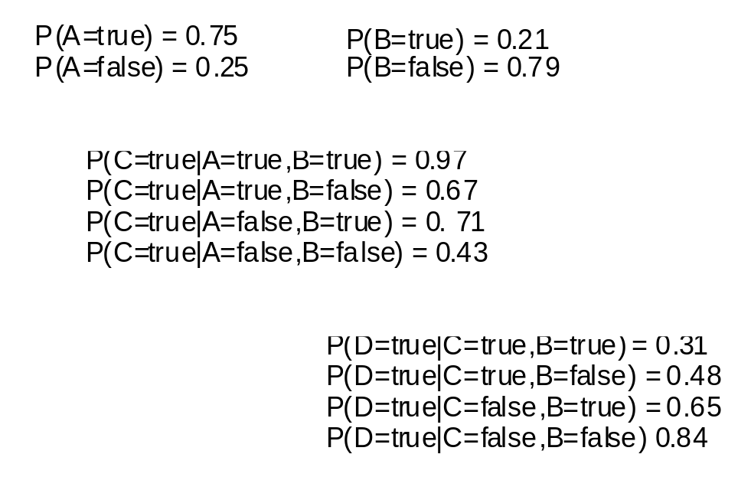
BBNs in a nutshell
Quantitative specification
Qualitative specification

Slide 9
BBNs in other domains
Medical domain
MS Office assistants
Windows problem analyzer
So why not SE?

Slide 10
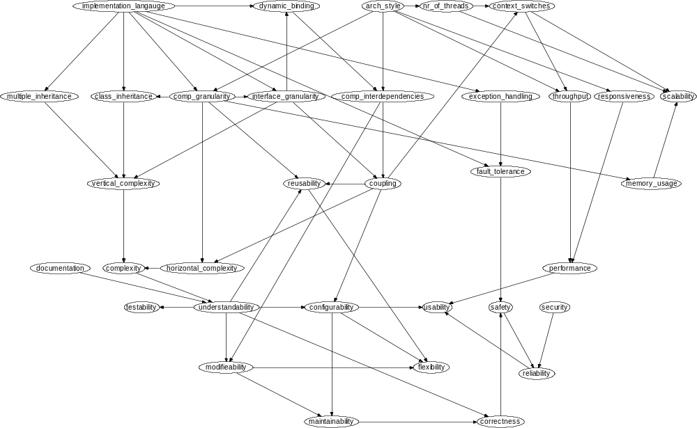
SAABNet

Slide 11
Three types of variables
Architecture Attributes
  programming language, inheritance
Quality Criteria
  complexity, coupling
Quality Factors
  maintenance, performance
More abstract

Slide 12
Usage
Insert what you know
Let the BBN calculate probabilities for what you don’t know

Slide 13
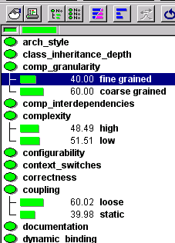
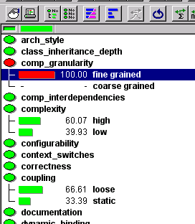
Usage (2)
The screenshots were taken from a tool called Hugin professional which is a modeling tool used for creating and testing BBNs. See www.hugin.com.

Slide 14
Usage Strategy
Diagnostic Use
Impact Analysis
Quality Attribute Prediction
Quality Attribute Fulfillment

Slide 15
Diagnostic Use
Input variables related to your problem
Examine other variables for anomalities to trace the causes of the problem

Slide 16
Impact Analysis
Enter the known variables of the future architecture
Examine the other variables for potential problems

Slide 17
Quality Attribute Prediction
Enter architecture attributes & criteria
Examine the Quality attributes for problems

Slide 18
Quality Attribute Fulfillment
Enter the desired Quality attributes
Observe the quality attributes and criteria

Slide 19
Validation
An embedded system
  Evaluation of existing architecture
  Impact of suggested changes in the architecture
Epoc 32
  Evaluation of Design
  Impact of QRs on Architecture

Slide 20
Our findings
We can explain SAABNets output (i.e. it doesn’t produce nonsense)
Given the limited input, the output is remarkably realistic

Slide 21
Value of SAABNet
It’s a prototype, not a solution
However, it shows that this way of treating qualitative knowledge
  is feasible
  and useful

Slide 22
Future work
Extend SAABNet to include more variables.
Build a more friendly GUI around SAABNet.
Do an experiment to verify whether a SAABNet based tool can help designers.

Slide 23
Conclusions
BBNs provide a way to reason with qualitative knowledge in SD.
Our validation shows that even with a small amount of variables the output can be useful.
More validation is needed.

Slide 24
Contact information
Jilles van Gurp
http://www.ipd.hk-r.se/jvg
jvg@ipd.hk-r.se
Jan Bosch
http://www.ipd.hk-r.se/jbo
jbo@ipd.hk-r.se
Högskolan Karlskrona/Ronneby in Sweden
Department of Software Engineering & Computer Science
http://www.ipd.hk-r.se/

